Slide 1
MICRO-PROJECT 13 • COURSE 25DC210
SERVER RESPONSE TIME
PREDICTION
REQ
CPU
Using Regression Models to study uncertainty in web-service performance
MEM
TIME
NET
Vian Alen Barnes • Dave V Shah • Jaswanth • Sujai
B.Tech Computer Engineering • Semester III • Dr. K. Rebecca Jebaseeli Edna
1

Slide 2
MICRO-PROJECT 13 • 25DC210
Problem, rationale & objectives
The statistical question in one view
Problem
Proposed approach
Objectives
Server response time changes with workload and system conditions. A single average cannot describe every request.
Represent workload as explanatory variables; use correlation and regression to estimate response time.
Summarise variation, explore trends, predict held-out observations and validate error statistically.
EXPECTED OUTCOME
A reproducible statistical workflow—not a claim that every request can be predicted exactly.
Karunya Institute of Technology and Sciences • Academic Year 2026–27
2

Slide 3
MICRO-PROJECT 13 • 25DC210
Methodology & system workflow
From performance observations to validated predictions
1
Define variables
2
Collect / simulate data
3
Clean & inspect
4
Descriptive stats + trend
5
Correlation
6
Regression fit
7
Test-set prediction
8
Error + hypothesis test
Analytical core: descriptive statistics → correlation → fitted regression → independent test evaluation
Karunya Institute of Technology and Sciences • Academic Year 2026–27
3

Slide 4
MICRO-PROJECT 13 • 25DC210
Course alignment & scope
Probability & Statistics • Units IV and V
Unit IV — Statistics
Prediction evaluation
Unit V — Validation
Descriptive measures, time-series trend, Pearson correlation and regression.
MAE, MSE, RMSE and R² compare predicted values with held-out observations.
Confidence-based reasoning and Student’s t-test, used with assumptions stated.
CO2: model uncertainty • CO3: predict under uncertain workload • CO4: justify statistically • CO5: validate with tests
Karunya Institute of Technology and Sciences • Academic Year 2026–27
4

Slide 5
MICRO-PROJECT 13 • 25DC210
Dataset design & variables
1,000 simulated time-series observations • seed = 42
Request rate
CPU usage
Memory usage
Network load
Response time
50–997 req/s
1.0–99.5 %
mean 41.03%, SD 12.84
1.02–51.83 MB/s
56.72–619.18 ms
Predictors
Request rate • CPU usage • memory usage • network load
Target variable: response time (milliseconds)
Synthetic data supports reproducibility; findings describe this generated dataset, not a live production server.
Karunya Institute of Technology and Sciences • Academic Year 2026–27
5

Slide 6
MICRO-PROJECT 13 • 25DC210
Descriptive statistics: centre and spread
Response time varies substantially across the dataset
Mean
Standard deviation
Range
Coefficient of variation
320.41 ms
118.97 ms
56.72–619.18 ms
≈ 37%
Arithmetic centre
Observed dispersion
Minimum to maximum
SD relative to mean
How to interpret the measures
• The standard deviation is large relative to the mean, showing meaningful spread.
• The range spans roughly eleven times from minimum to maximum.
• These summaries describe the observed sample; they do not alone establish prediction quality.
Karunya Institute of Technology and Sciences • Academic Year 2026–27
6

Slide 7
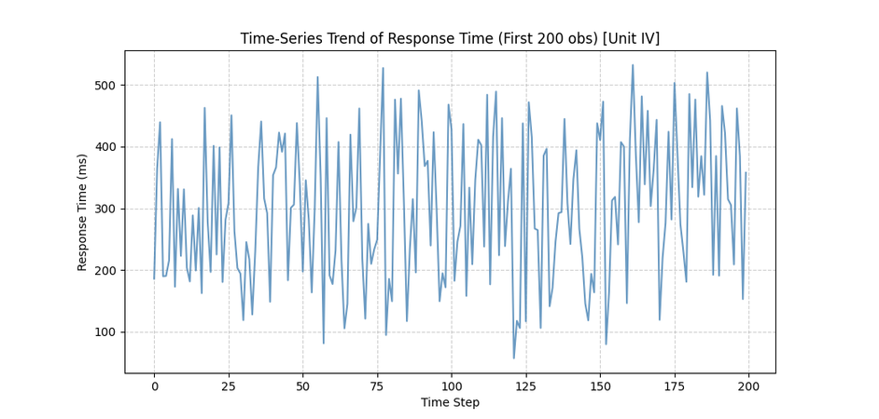
MICRO-PROJECT 13 • 25DC210
Time-series trend
A small positive drift was engineered into the sequence
Reported trend component
+0.05 ms per time step was engineered into the generated series.
Correlation with time step
r = 0.1249 — weak positive association.
Trend chart is schematic; reported statistics are from the project deck.
ACTUAL GENERATED TIME-SERIES OUTPUT
Karunya Institute of Technology and Sciences • Academic Year 2026–27
7

Slide 8
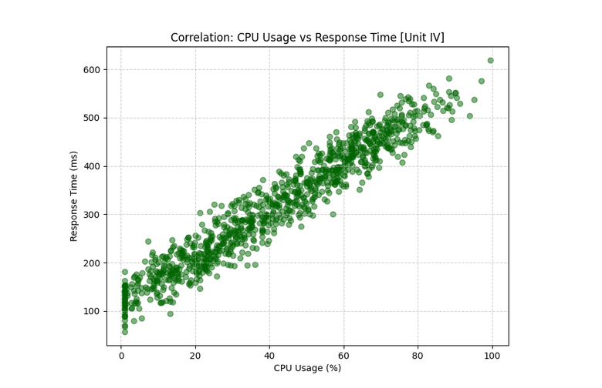
MICRO-PROJECT 13 • 25DC210
Correlation analysis
Pearson correlation with response time (n = 1,000)
Strongest association
CPU usage: r = 0.9637
Interpretation
All four workload predictors are strongly positively associated with response time.
Correlation indicates association, not causation. Correlated predictors can affect coefficient stability.
OUTPUT SCREENSHOT • CPU VS RESPONSE TIME
Karunya Institute of Technology and Sciences • Academic Year 2026–27
8

Slide 9
MICRO-PROJECT 13 • 25DC210
Multiple linear regression
The fitted equation estimates response time from four predictors
Ŷ = 73.53 + 0.052(Request Rate) + 2.416(CPU) + 1.447(Memory) + 2.220(Network)
Intercept
Request rate
CPU usage
Memory usage
Network load
73.53
0.052
2.416
1.447
2.220
Coefficients describe fitted conditional relationships. Because predictors may be correlated, interpret individual effects cautiously.
Karunya Institute of Technology and Sciences • Academic Year 2026–27
9

Slide 10
MICRO-PROJECT 13 • 25DC210
Model fitting & test design
Separate model development from evaluation
TRAINING SET • 800 OBSERVATIONS
TEST SET • 200 OBSERVATIONS
Fit ordinary least-squares regression
Evaluate predictions on held-out data
Actual vs predicted
Residual
Error metrics
Compare each test response with its model estimate.
Residual = actual − predicted.
Summarise typical and squared error.
Karunya Institute of Technology and Sciences • Academic Year 2026–27
10

Slide 11
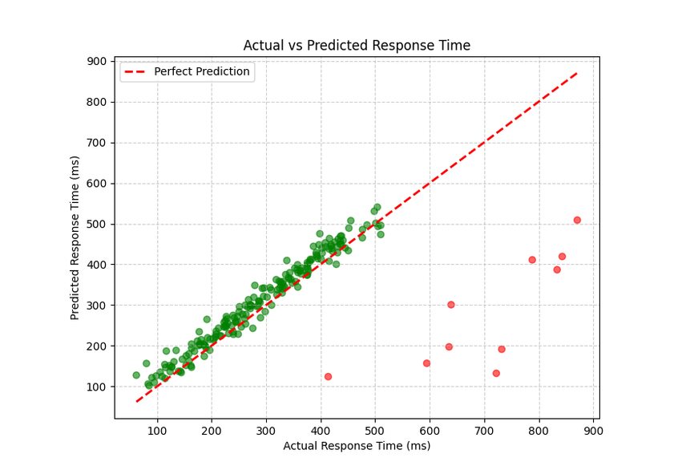
MICRO-PROJECT 13 • 25DC210
Prediction accuracy
Held-out test set • 200 observations
MAE
RMSE
R²
20.21 ms
25.26 ms
0.9505
Average absolute error
Penalises larger errors
95.05% variance explained
The reported RMSE is about 25% higher than MAE. Together with R², these metrics indicate a strong fit on this generated test set.
ACTUAL MODEL OUTPUT • PREDICTED VS ACTUAL
Accuracy is bounded by the simulated data design and observed workload range.
Karunya Institute of Technology and Sciences • Academic Year 2026–27
11

Slide 12
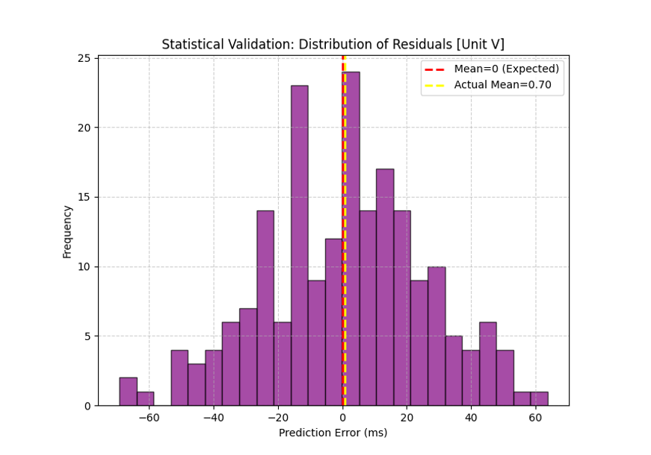
MICRO-PROJECT 13 • 25DC210
Hypothesis testing: mean residual
Student’s one-sample t-test • α = 0.05
Null hypothesis (H₀)
Alternative (H₁)
Reported result
Mean prediction error = 0
Mean prediction error ≠ 0
t = 0.3931 • p = 0.6947
Since p > 0.05, fail to reject H₀: the test does not find evidence of a non-zero mean residual.
This is not proof that every prediction is unbiased; the conclusion depends on test assumptions and the residual sample.
ACTUAL MODEL OUTPUT • RESIDUAL DISTRIBUTION
Karunya Institute of Technology and Sciences • Academic Year 2026–27
12

Slide 13
MICRO-PROJECT 13 • 25DC210
Results dashboard & interpretation
Key findings in one evidence-led view
CPU correlation
0.9637
Model fit
R² = 0.9505
Request rate
0.9423
Network load
0.9388
Average miss
MAE = 20.21 ms
Memory usage
0.9099
Interpretation: strong linear signal in the simulated data; validate further on real telemetry before operational use.
OUTPUT EVIDENCE • TEST-SET PREDICTIONS
Karunya Institute of Technology and Sciences • Academic Year 2026–27
13

Slide 14
MICRO-PROJECT 13 • 25DC210
Limitations, applications & future scope
What the project supports—and what it does not claim
Demonstrated
Limitations
Future work
• Reproducible 1,000-row simulated dataset
• Correlation and multiple regression
• Held-out error evaluation
• Residual hypothesis test
• Synthetic rather than live server data
• Engineered predictor relationships
• Correlation is not causation
• Generalisation beyond range is unknown
• Collect validated real measurements
• Compare alternative regression models
• Check residual assumptions
• Test temporal holdout and drift
Potential use: performance monitoring baselines and capacity-planning experiments
Karunya Institute of Technology and Sciences • Academic Year 2026–27
14

Slide 15
MICRO-PROJECT 13 • 25DC210
Conclusion & references
Statistics turns observed variation into an interpretable prediction
• Four workload variables show strong positive correlation with response time.
• The fitted regression reports R² = 0.9505 on the 200-observation test set.
• MAE = 20.21 ms and RMSE = 25.26 ms summarise prediction error.
• The t-test does not reject a zero mean residual at α = 0.05.
REFERENCES / EVIDENCE
25DC210 course syllabus and supplied proposal.
Montgomery, Peck & Vining, Introduction to Linear Regression Analysis.
Project dataset and reported experiment outputs.
THANK YOU • Questions & discussion
Karunya Institute of Technology and Sciences • Academic Year 2026–27
15

